Slide 1
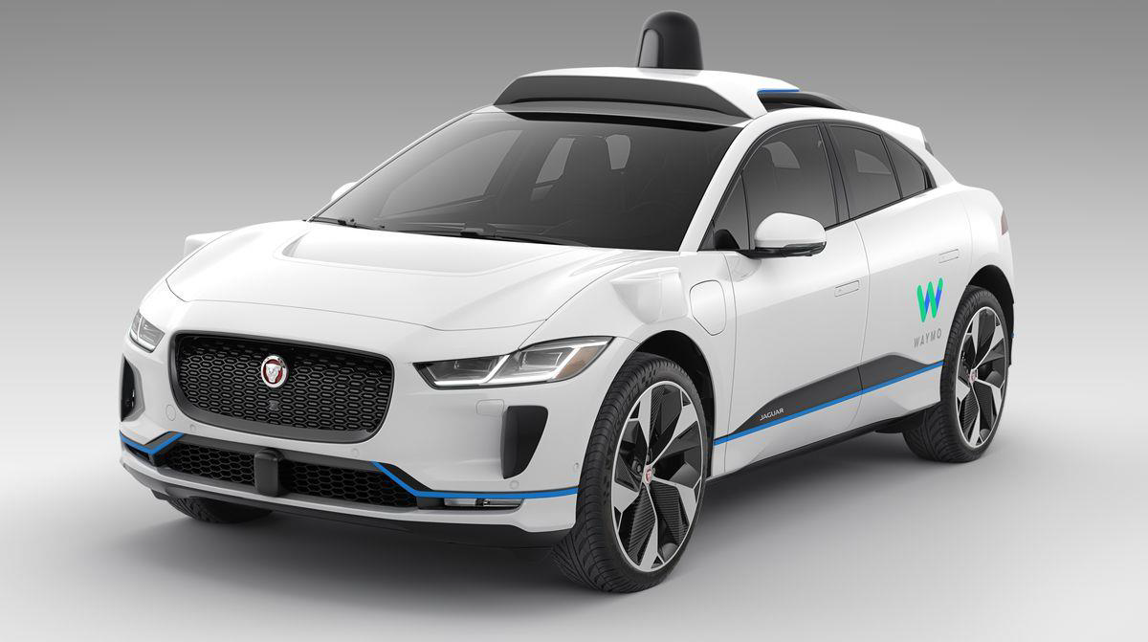
A Visual Perception of Self-driving Cars

Slide 2
Presented by:
Abdelrahman Abdelmoneam
Omar Khaled
Under the supervision of:
Dr. Ashraf Al-Marakeby

Slide 3
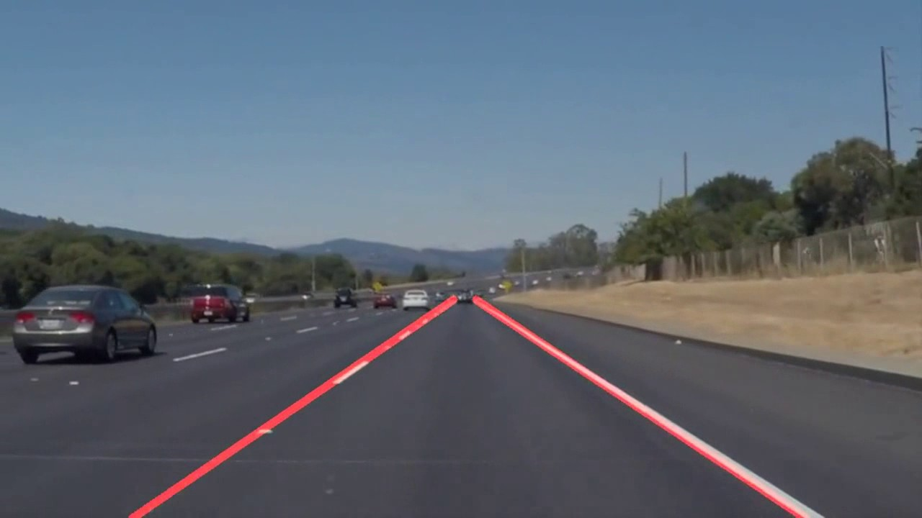
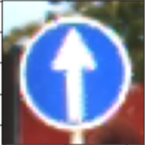
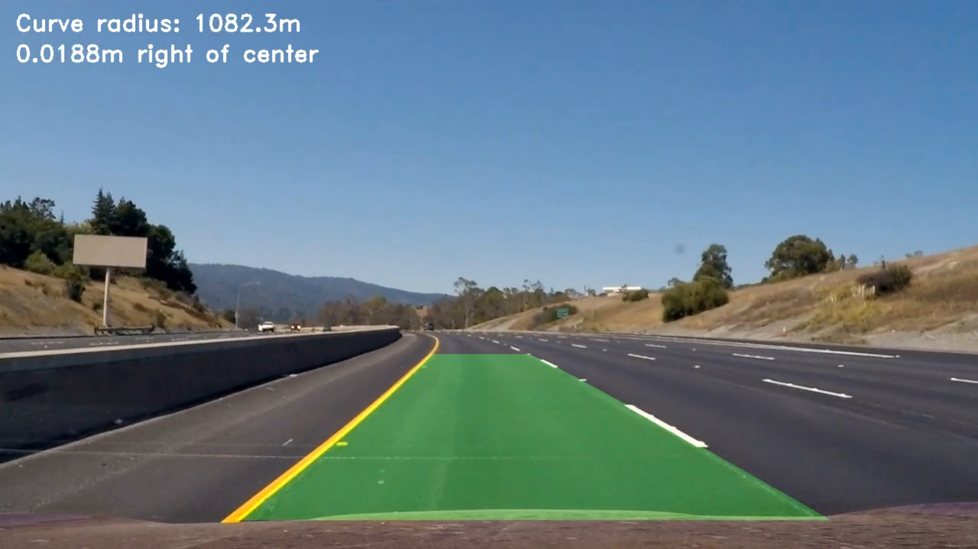
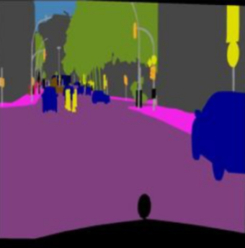
CONTENTS
•Introduction
•Straight Lane Keeping
•Curved Lane Keeping
•Traffic-Sign Classifier
•Semantic Segmentation
•Future Work

Slide 4
INTRODUCTION
What is a self-driving car?

Slide 5
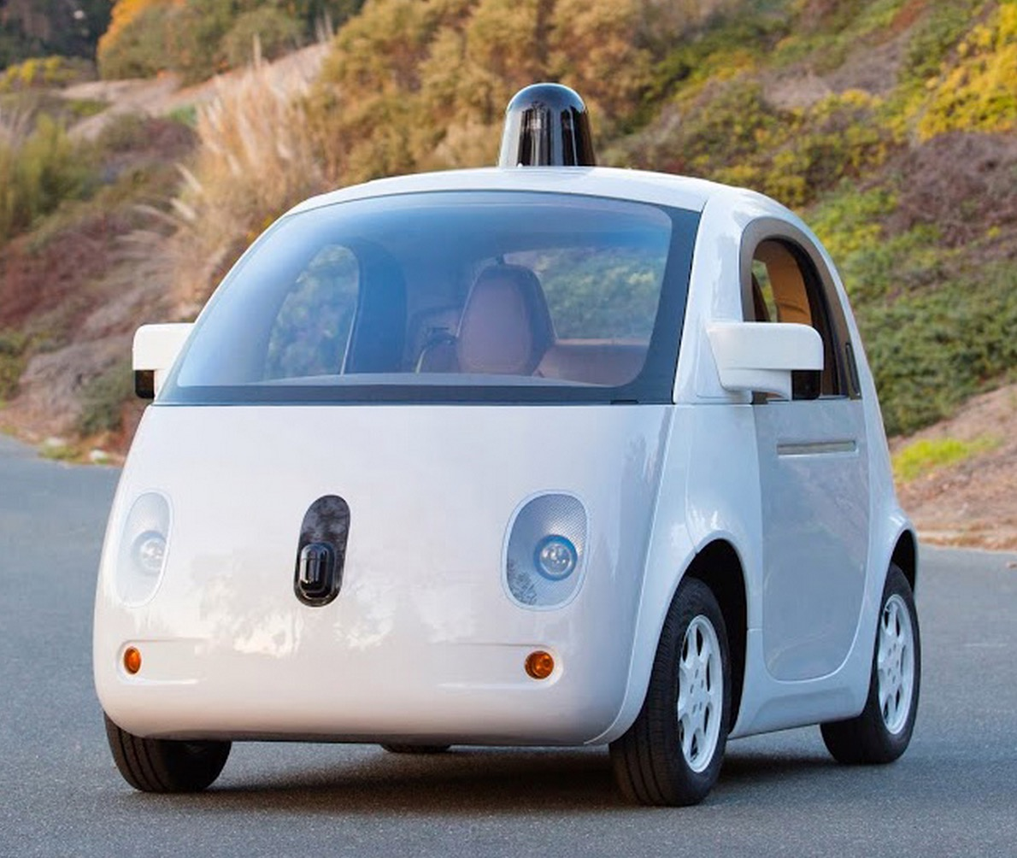
What is a self-driving car?
•It is a vehicle that is capable of sensing its environment and navigating without a human input.

Slide 6
Benefits
Fewer accidents
Decreased traffic congestion
Eliminated hunting for parking
Enhanced human productivity

Slide 7
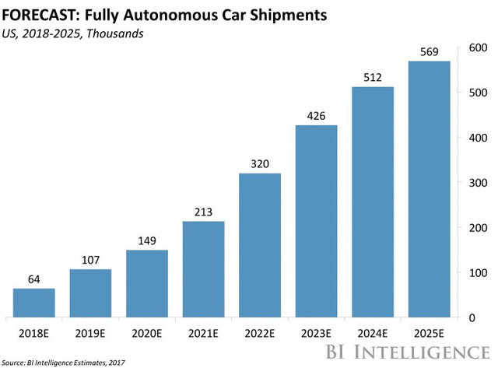
Spread

Slide 8
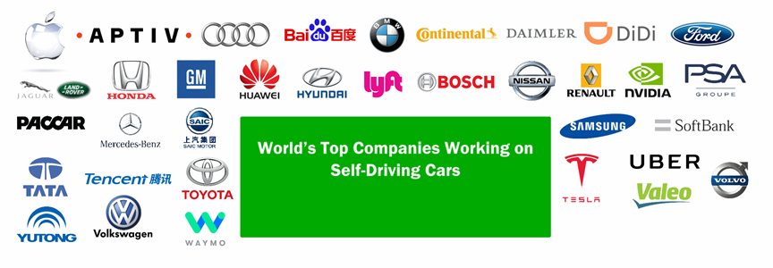

Slide 9
Some features of self-driving cars
Forward Collision Avoidance
Lane Keeping
Vehicle-to-Vehicle Communication
Traffic Signs Recognition

Slide 10
STRAIGHT LANE KEEPING

Slide 11
FINDING LANE LINES
•Detecting highway lane lines on a video stream using OpenCV image analysis techniques to identify lines like Canny edge detection and Hough transform.

Slide 12
Steps
•Convert image to grayscale for easier manipulation
•Gaussian Blur (Smoothing)
•Canny Edge Detection
•Hough Transform

Slide 13
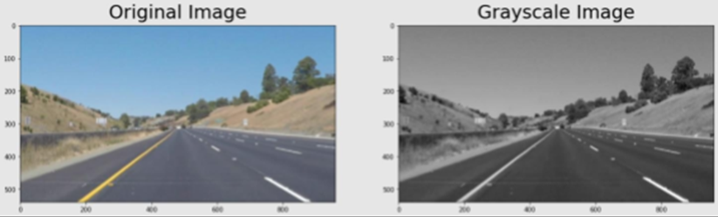
Grayscale Images

Slide 14
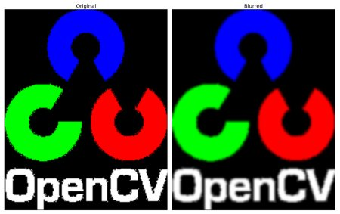
Smoothing
•As we need to reduce the number of lines we detect, we want to focus only on the most significant lines (the lane ones), not those on every object, so now it comes to smoothing or blurring.

Slide 15
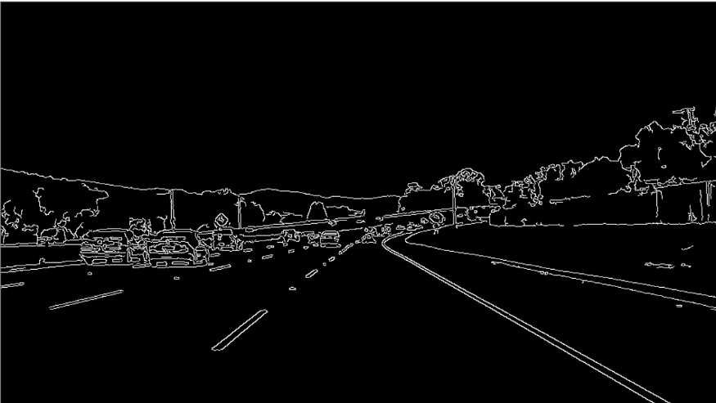
Canny Edge Detection (Intensity of gradient)

Slide 16
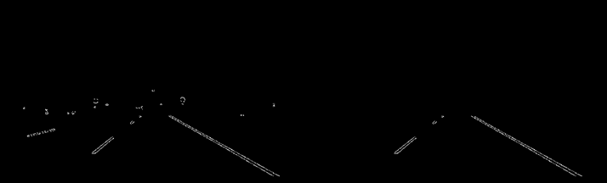
Extracting the Region of Interest

Slide 17
Hough Transform
•The goal of Hough transform is to find lines by identifying all points that lie on them.
•We need to connect all segments that lie on a lane line to form a line that fits them all.

Slide 18
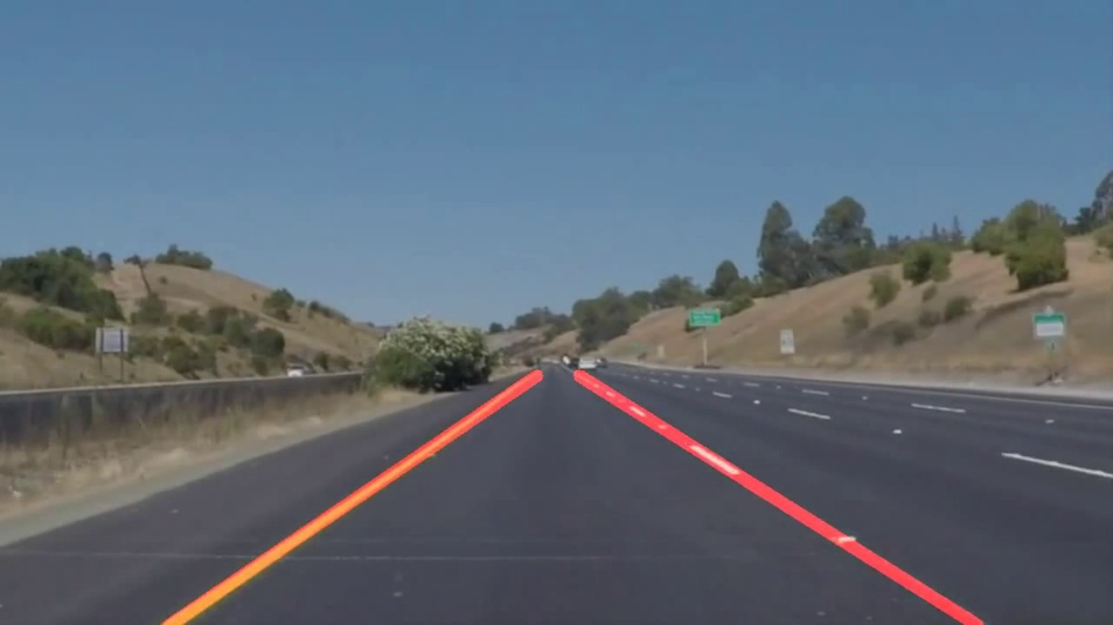
Final Result

Slide 19
Traffic Sign Recognition

Slide 20
The Goal and Challenge
Enable The car to recognize and understand 43 kinds of images to be able to make a better decisions.
Requires high-performance software with low quality data.

Slide 21
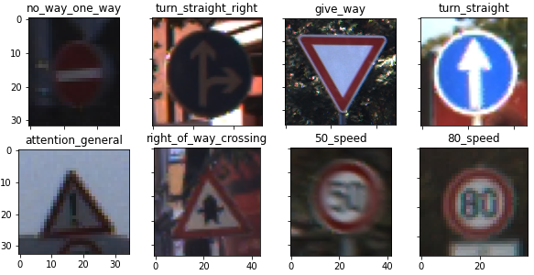
German Traffic Sign DataSet
يييييي

Slide 22
DataSet Pre-Processing
DataSet Contains 39000 file image.
Each file image has real image and the label of it.
Split Dataset to 80% for training and the rest for testing.
Extracting Data from File and build our own dataset to match with deep learning frameworks.

Slide 23
Architecture of the Network
Transfer Learning.
GPU Vs CPU.
VGG 16.
Image Net.
Convolutional Neural Network from Scratch.

Slide 24

VGG 16 Architecture

Slide 25
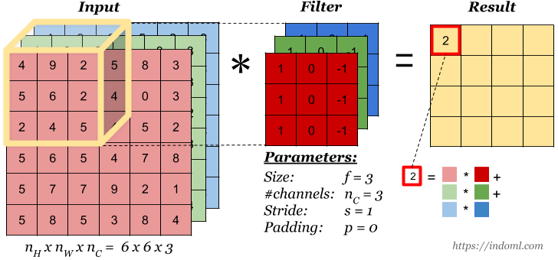
2D Convolution with 3 Channels

Slide 26
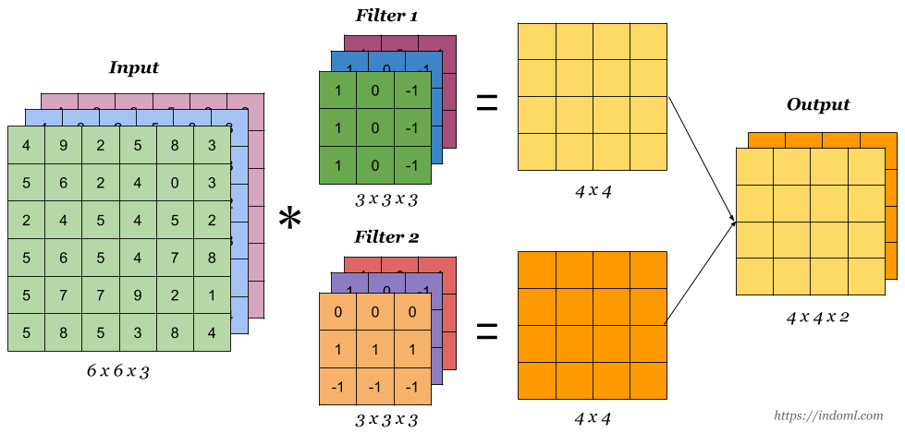

Slide 27
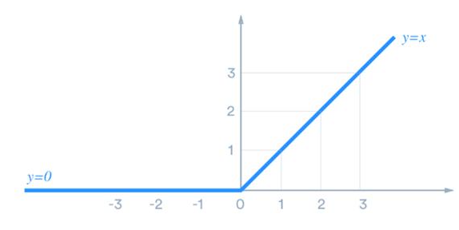
ReLU ⇒ Source Of Non Linearity
F(x) = Max(0, x)

Slide 28
Why we need activation functions?
a⁽¹⁾ = a⁽⁰⁾ x W1 a⁽²⁾ = a⁽¹⁾ x W2 = a⁽⁰⁾ x W1 x W2 = a⁽⁰⁾ x W

Slide 29
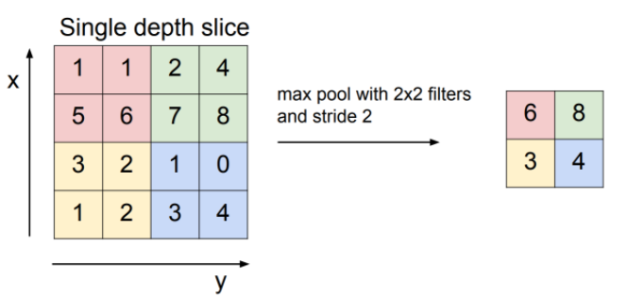
Max Pooling

Slide 30
VGG 16 Architecture

Slide 31
Define the error function
Our goal
p(turn_straight | x^{(i)}) is high if y^{(i)} = turn_straight
We want to maximize p(y^{(i)} | x^{(i)}) - High p(y^{(i)} | x^{(i)}) ⇒ Low error - Low p(y^{(i)} | x^{(i)}) ⇒ High error

Slide 32
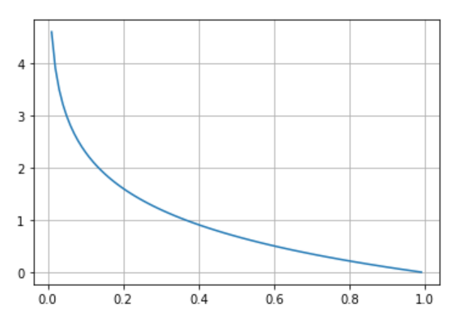
Log Function
E^{(i)} = - log(p(y^{(i)} | x^{(i)}))

Slide 33
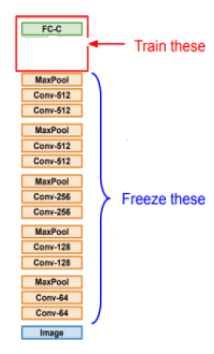
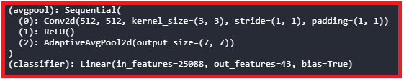
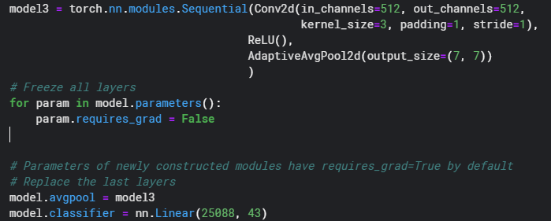

Slide 34
Hyper Parameters
Learning_rate ⇒ 1e-3
Batch_size ⇒ 16
Epochs ⇒ 80

Slide 35
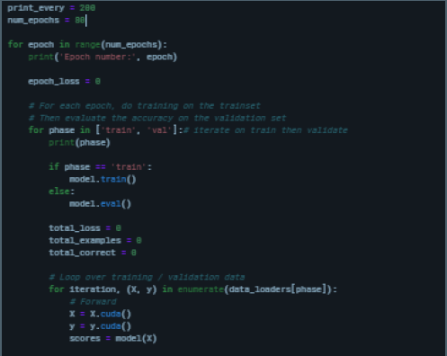
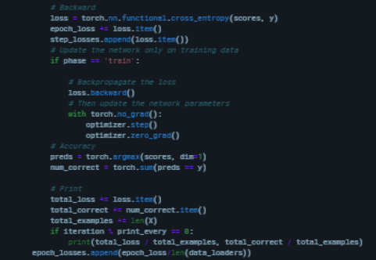
Optimization Loop

Slide 36
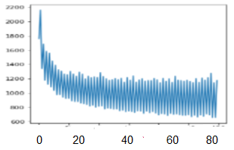
Accuracy
After training the network over 80 epochs, the training accuracy becomes 85% and testing accuracy is 75%.
Stuck in local minimum and can’t reach
to the global minimum.

Slide 37
Optimized Solution!

Slide 38
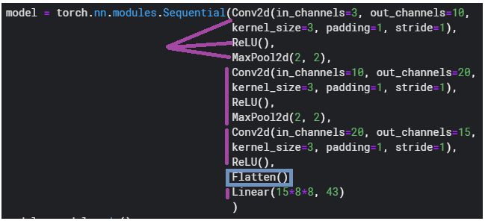
CNN From Scratch

Slide 39
Hyper Parameters
Learning_rate ⇒ 1e-3
Batch_size ⇒ 16
Epochs ⇒ 80

Slide 40
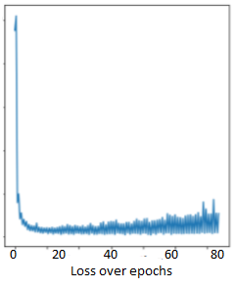
Accuracy!
After training the network over 80 epochs, the training accuracy has been increased to 99% and testing accuracy to 98.5%.
The Network reached the region
of global minimum after a little bit of epochs,
then some of oscillation happened to
reach to the best point.

Slide 41
ADVANCED LANE FINDING

Slide 42
Steps
•Distortion Correction
•Perspective Transform
•Creating a Thresholded Binary Image
•Calculating Lane Curvature

Slide 43
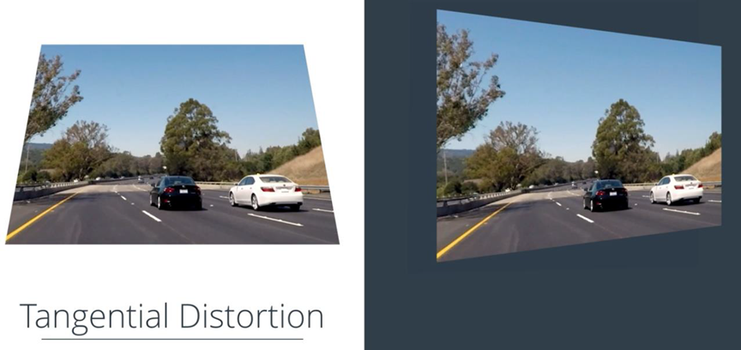
Distortion

Slide 44
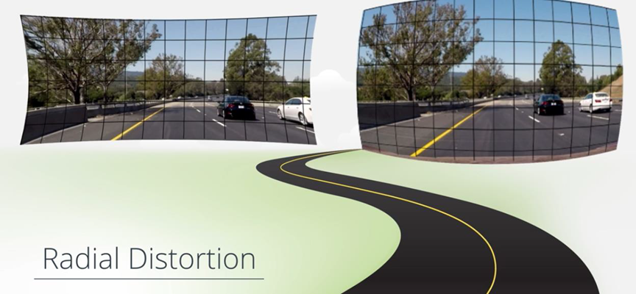

Slide 45
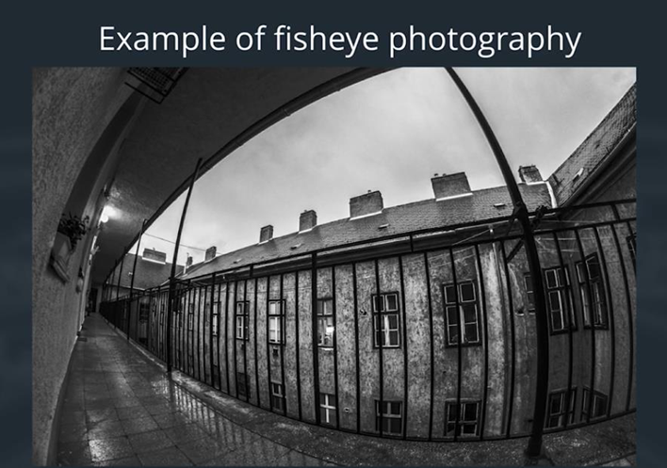

Slide 46
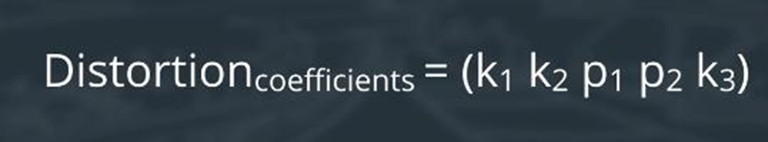
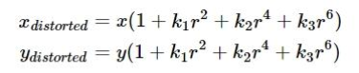
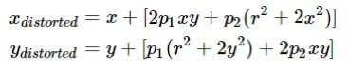

Slide 47
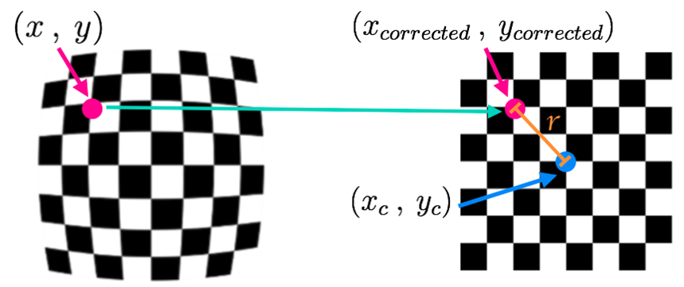

Slide 48
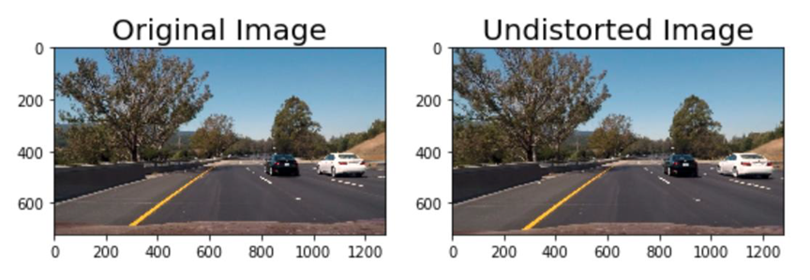

Slide 49
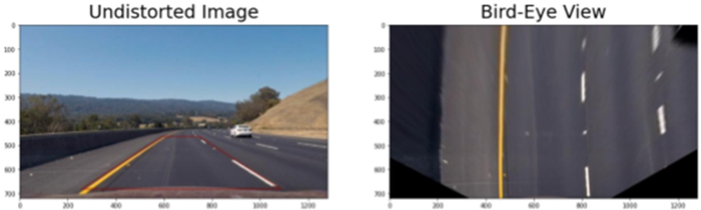
Perspective Transform

Slide 50
Color Thresholding
B channel of LAB color space ⇒ Yellows
L channel of the HSL color space ⇒ Whites

Slide 51
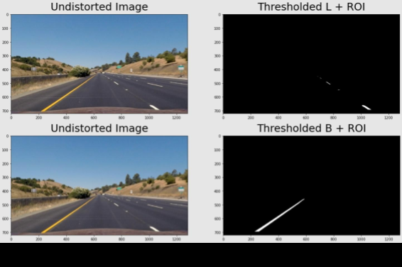

Slide 52
Results after running the pipeline:

Slide 53
SEMANTIC SEGMENTATION

Slide 54
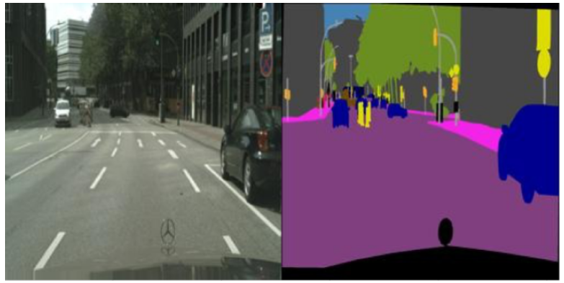
The Goal
Enable the car to be able to Segment all objects of the scene and classify each pixel to the suitable class

Slide 55
Why ?
one of the fundamental tasks in the field of computer vision
because it can be considered as a substantial preprocessing
tool for other tasks, including object detection, and scene understanding.

Slide 56
Cityscapes Dataset
Dataset is a Collection of recorded videos of vehicles driven in Germany in different seasons and different times of the day.
Dataset has 2975 training images files and 500 validation image files.

Slide 57
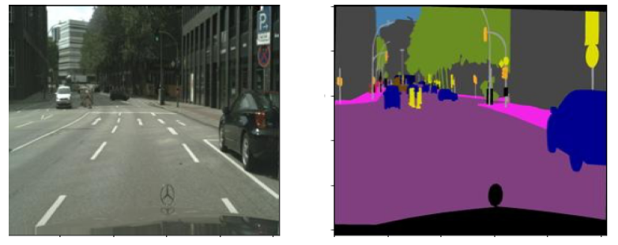
Data Preprocessing
Each data in the data file is about one combined image, the left half represents the
landscape(real image) and the right half represents the ground truth (label) of the landscape.

Slide 58
Label Clustering
The label image is three channels, so we have to convert it to one channel manner so we can do training as supervised learning because each pixel in the landscape image, the corresponding of its in label image has to be a number represents the number of true class.
Using K-Means Cluster algorithm the problem has been solved.

Slide 59
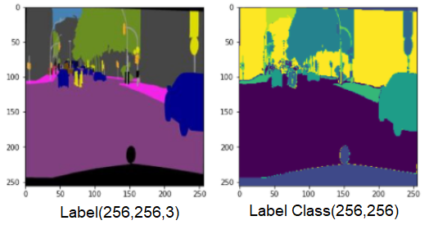
K-means Algorithm
It's an iterative algorithm that tries to partition the dataset into K pre-defined
distinct non-overlapping subgroups where each data point belongs to only one group.

Slide 60
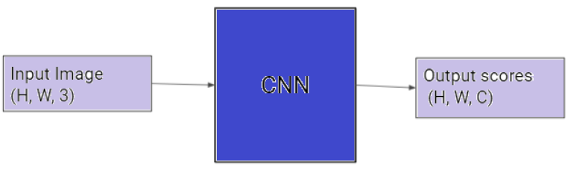
The Architecture Of The Network
Fully Convolutional Neural Networks
Because we want the output shape of the network equals the input shape of the network, we have to use FCNN rather than the normal CNN.
In CNN the architecture has fully connected layers in the last layers and this idea is not suitable for this task, where we want the desired output includes localization.

Slide 61
U-Net Paper
The architecture consists of a contracting path to capture context and a symmetric expanding path that enables precise localization.
The main idea of the architecture is to supplement a usual contracting network by successive layers, where pooling operators are replaced by upsampling operators.Where, these layers increase the resolution of the output. In order to localize, high resolution features from the contracting path are combined with the upsampled output.A successive convolution layer can then learn to assemble a more precise output based on this information.

Slide 62
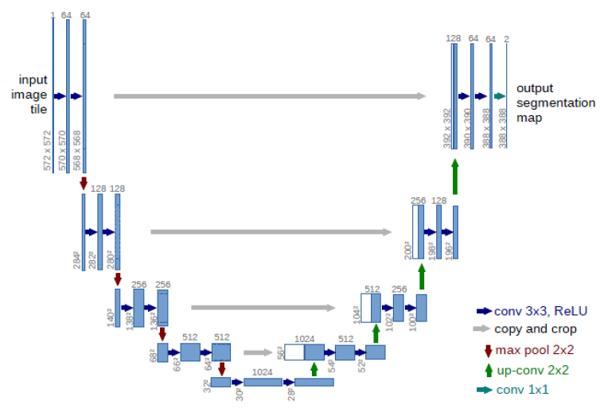

Slide 63
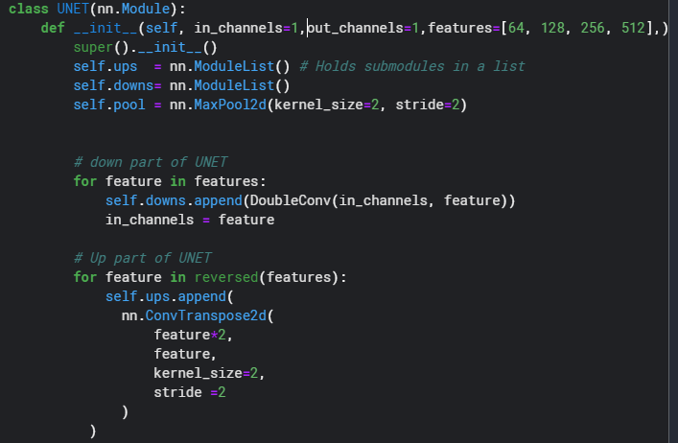
Paper Implementation

Slide 64
Hyberparamets
Batch_size ⇒ 16
Epochs ⇒ 240
Learning rate ⇒ 1e-3
The training data in terms of patches is much larger than the number of training images.

Slide 65
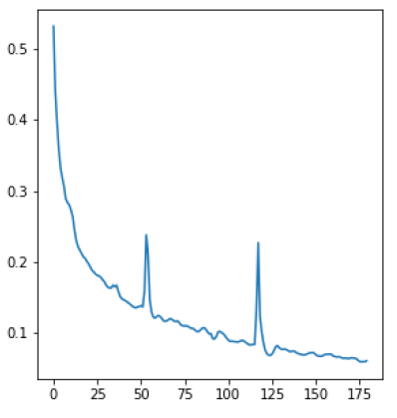
Loss Function

Slide 66
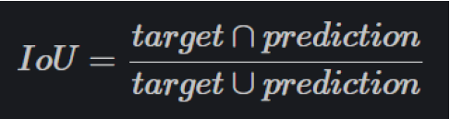
Intersection Over Union
The Intersection over Union (IoU) metric, is essentially a method to quantify the percept overlap between the target mask and our prediction output.
The IoU metric measures the number of pixels common between the target and prediction masks divided by the total number of pixels present across both masks.

Slide 67
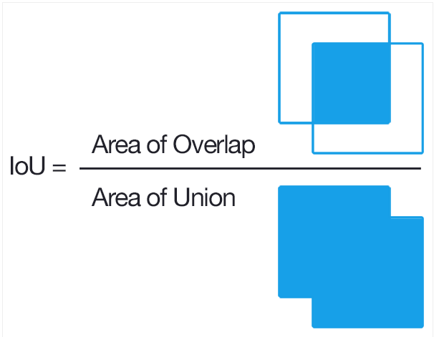

Slide 68
Accuracy!
After Training of 240 epochs on a strong GPU and using IoU score to evaluate, we
finally have achieved accuracy higher than 98%.

Slide 69
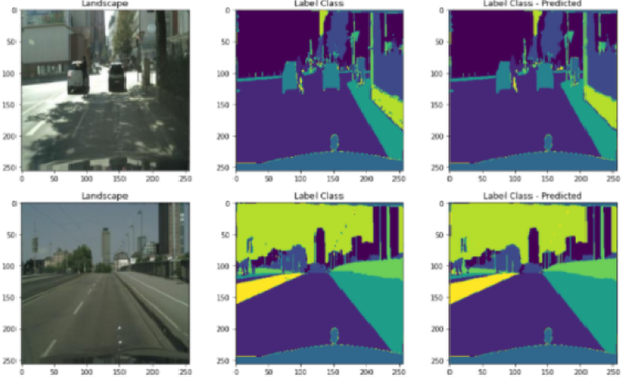
Visualization

Slide 70
Future Work
In the future we aim to produce an integration of these models and apply them upon an environment.
We also hope to apply that integration mentioned above on a dataset consisting of images of local roads instead of relying on datasets from other countries like The United States and Germany due to lack of resources.

Slide 71
Thank You!

